Slide 1
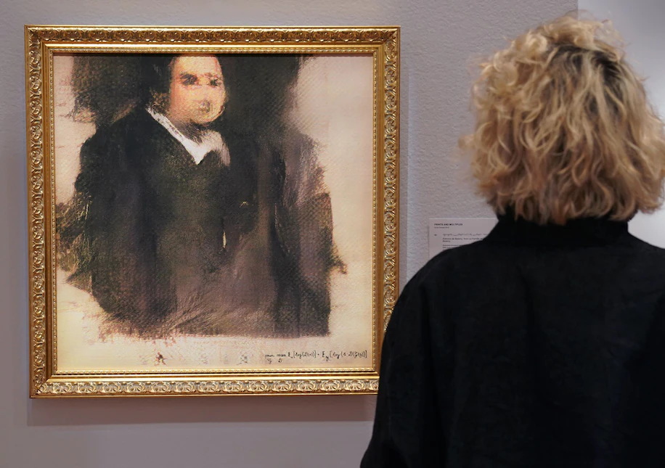
Slides by Raghav Bali (raghavbali.github.io)
Image Source:
Edmond de Belamy, from La Famille de Belamy (link)
https://www.washingtonpost.com/nation/2018/10/26/year-old-developed-code-ai-portrait-that-sold-christies/
Notes:
Slides by Raghav Bali (raghavbali.github.io)

Slide 2
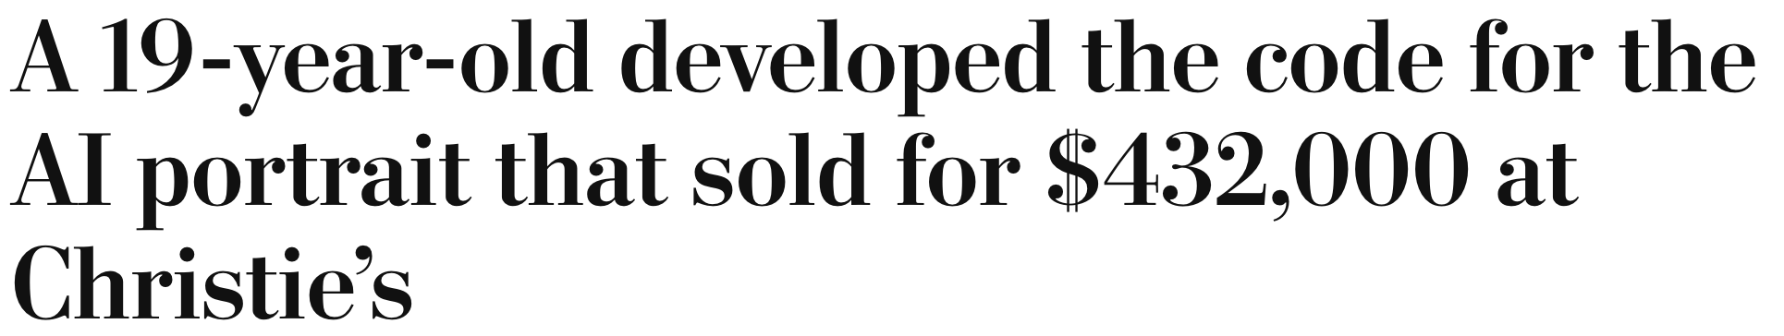
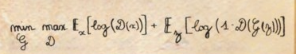
Slides by Raghav Bali (raghavbali.github.io)
Image Source:
Edmond de Belamy, from La Famille de Belamy (link)
https://www.washingtonpost.com/nation/2018/10/26/year-old-developed-code-ai-portrait-that-sold-christies/
Notes:
Slides by Raghav Bali (raghavbali.github.io)

Slide 3
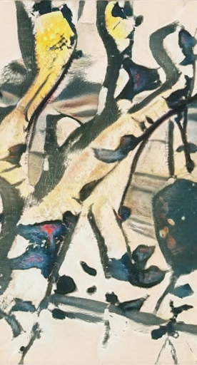
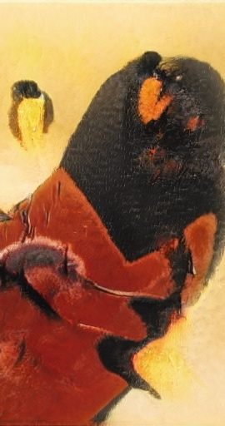
Slides by Raghav Bali (raghavbali.github.io)
Generating Images with GANs
Raghav Bali
Image Sources: https://thisartworkdoesnotexist .com/
Notes:
Slides by Raghav Bali (raghavbali.github.io)

Slide 4

Agenda
Slides by Raghav Bali (raghavbali.github.io)
About Me
Machine Learning Landscape
Generative Modeling
Generative Adversarial Networks
Generate Images : Hands-on
Challenges
Q/A
Image Sources: https://thisartworkdoesnotexist .com/
Notes:
Slides by Raghav Bali (raghavbali.github.io)

Slide 5
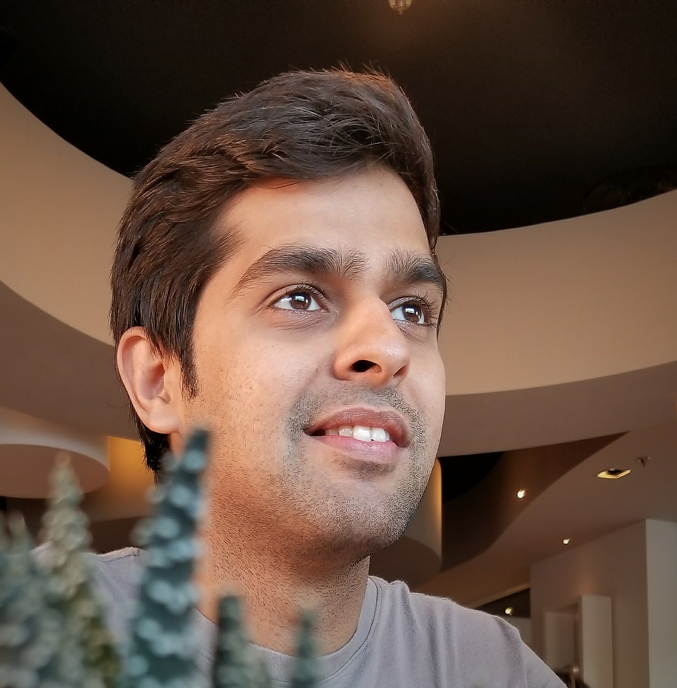

Raghav Bali
Slides by Raghav Bali (raghavbali.github.io)
Staff Data Scientist at DeliveryHero (Berlin)
A decade’s experience involving research & development of enterprise level solutions based on Machine Learning, Deep Learning, Computer Vision, NLP, Generative Models and Augmented Realityfor real world use-cases.
Notes:
Slides by Raghav Bali (raghavbali.github.io)

Slide 6
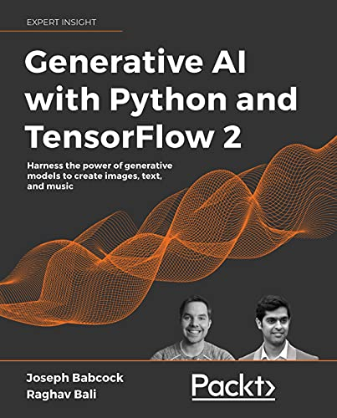
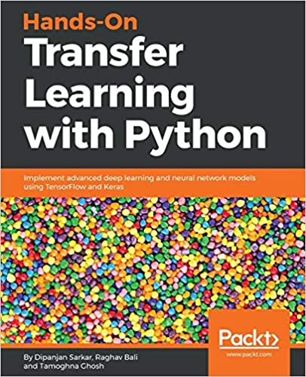
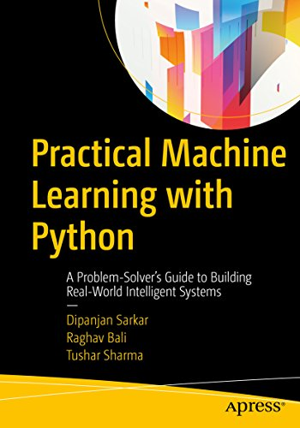
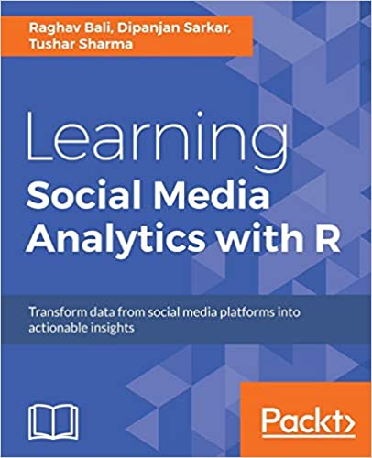
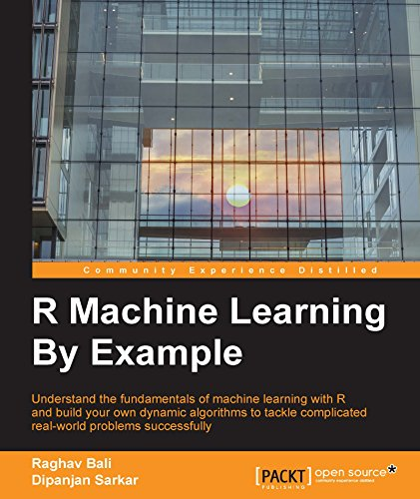
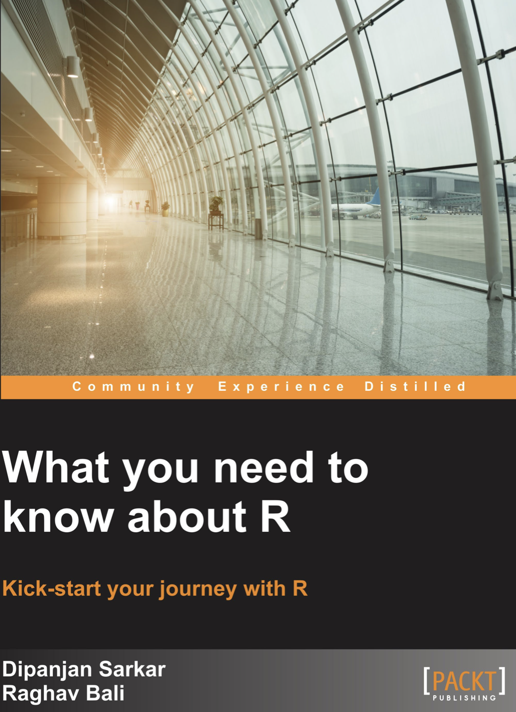
Raghav Bali : Publications
Slides by Raghav Bali (raghavbali.github.io)
Talks/Workshops at leading conferences such as Analytics Vidhya, SpringBoard, ODSC, etc.
Patents: 7 patents in the field of healthcare, deep learning, machine learning and NLP
Papers
Preprint 2022: Easter2.0: Improving Convolutional Models for Handwritten Text Recognition
IEEE SSCI 2021, An Interpretable Deep Learning System for Automatically Scoring Request for Proposals
IEEE ICTAI 2021, Exclusion and Inclusion--A model agnostic approach to feature importance in DNNs
CAIAC 2021, EASTER: Simplifying Text Recognition using only 1D Convolutions
CAIAC 2021, A Simple and Interpretable Predictive Model for Healthcare
IEEE SmartData 2016, Real Time Failure Prediction of Load Balancers and Firewalls
Books
Notes:
Slides by Raghav Bali (raghavbali.github.io)

Slide 7
Generative Modeling
Slides by Raghav Bali (raghavbali.github.io)
Generative models are a class of models in the unsupervised machine learning space
These help us model the underlying distributions responsible for generating the dataset under consideration
“
There is tremendous amount of data easily accessible in most cases. Generative models analyze and understand such datasets
”
Notes:
Slides by Raghav Bali (raghavbali.github.io)

Slide 8
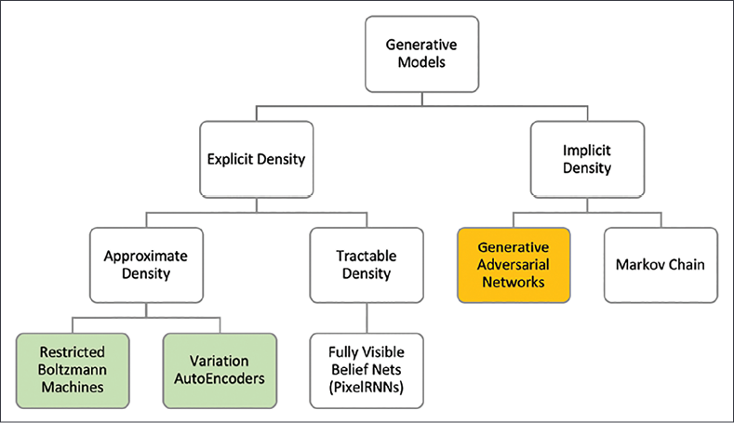
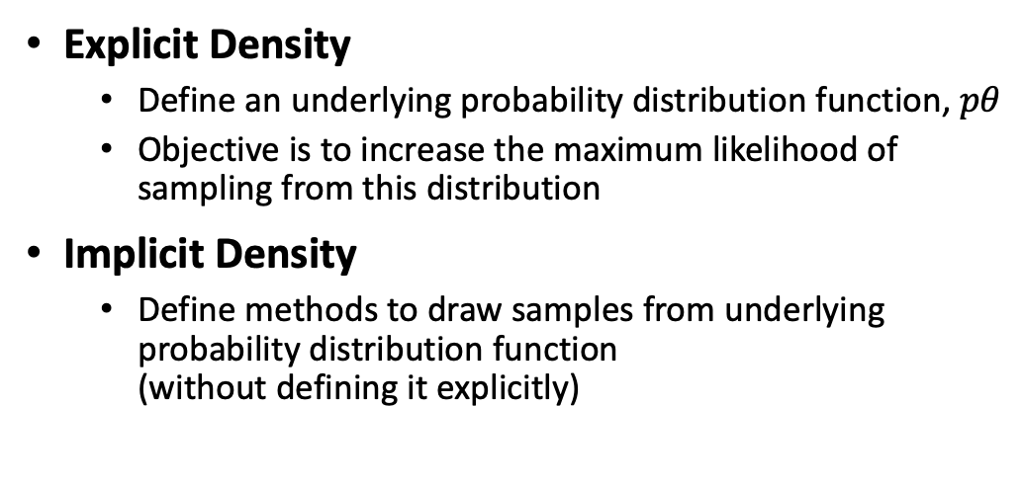
Generative Modeling: Topology
Slides by Raghav Bali (raghavbali.github.io)
Explicit Density
Define an underlying probability distribution function, $pθ$
Objective is to increase the maximum likelihood of sampling from this distribution
Implicit Density
Define methods to draw samples from underlying probability distribution function (without defining it explicitly)
Notes:
Slides by Raghav Bali (raghavbali.github.io)

Slide 9
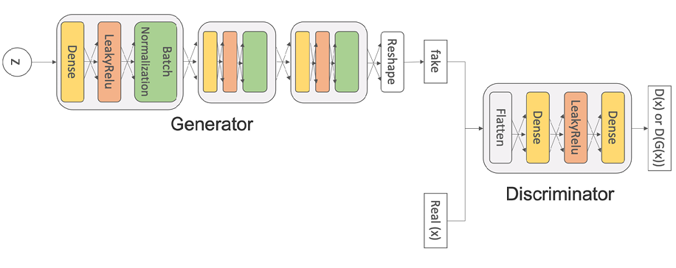
Generative Adversarial Networks
Slides by Raghav Bali (raghavbali.github.io)
GANs are implicit density functions which sample directly from the underlying distribution.
The adversaries compete against each other under well-defined reward functions and each player tries to maximize its rewards
Discriminator Vs Generator
Notes:
Slides by Raghav Bali (raghavbali.github.io)

Slide 10
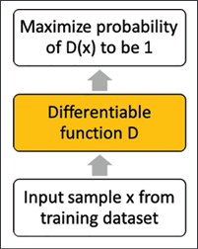
GAN: Discriminator
Slides by Raghav Bali (raghavbali.github.io)
A differentiable function that tries to maximize a probability of 1 for samples drawn from the training distribution.
The discriminator is also used to classify whether the output from the generator is real or fake.
We denote the discriminator model as D and its output as D(x).
Notes:
Slides by Raghav Bali (raghavbali.github.io)

Slide 11
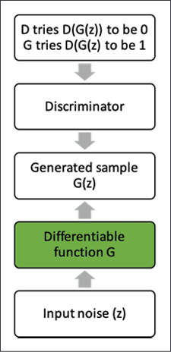
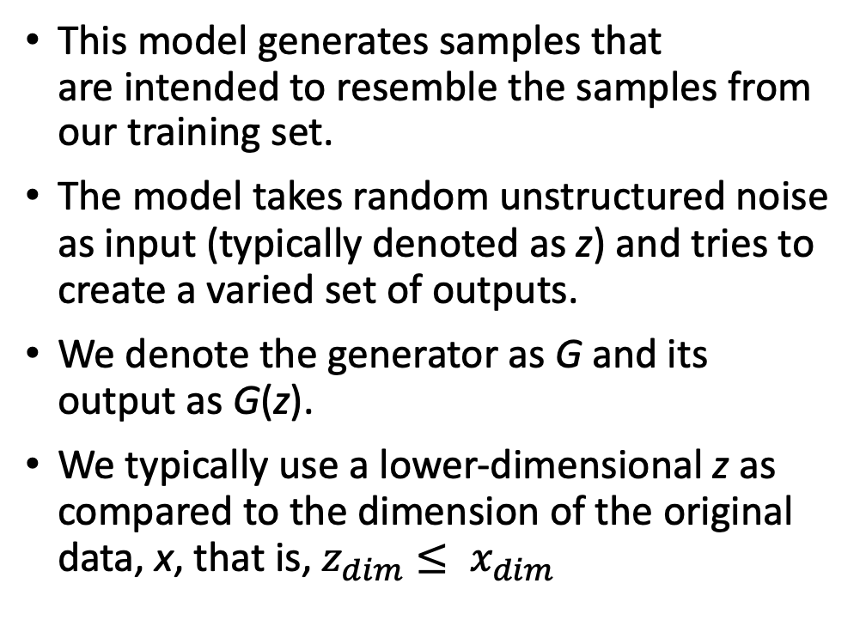
GAN: Generator
Slides by Raghav Bali (raghavbali.github.io)
This model generates samples that are intended to resemble the samples from our training set.
The model takes random unstructured noise as input (typically denoted as z) and tries to create a varied set of outputs.
We denote the generator as G and its output as G(z).
We typically use a lower-dimensional z as compared to the dimension of the original data, x, that is, $z_{dim}≤ x_{dim}$
Notes:
Slides by Raghav Bali (raghavbali.github.io)

Slide 12
GAN: Training
Slides by Raghav Bali (raghavbali.github.io)
Training a GAN is like playing this game of two adversaries.
More formally, this is termed as the minimax game, where the value function V(G, D) is described as follows:
Discriminator Loss
Generator Loss
Notes:
Slides by Raghav Bali (raghavbali.github.io)

Slide 13
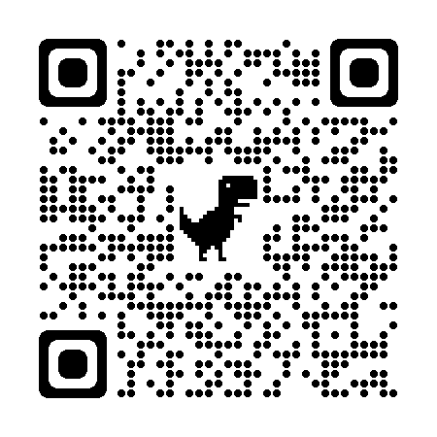

Hands-on
Slides by Raghav Bali (raghavbali.github.io)
GitHub Repo
Scan Me
Generate Images
Notes:
Slides by Raghav Bali (raghavbali.github.io)

Slide 14
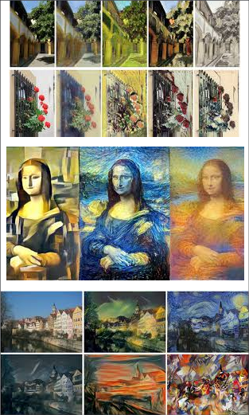
Generative Modeling: Applications
Slides by Raghav Bali (raghavbali.github.io)
Productive Applications
Image Denoising
In-painting
Super-resolution
Music generation
Text generation
Style transfers… and many more
Malicious Applications
Pornography & Identity theft
Fake-News/Misinformation spread
Notes:
Slides by Raghav Bali (raghavbali.github.io)

Slide 15
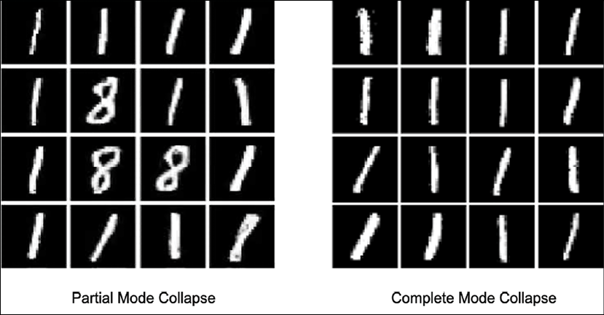
Challenges
Slides by Raghav Bali (raghavbali.github.io)
Training Instability
Mode Collapse
Uninformative Loss
Notes:
Slides by Raghav Bali (raghavbali.github.io)

Slide 16
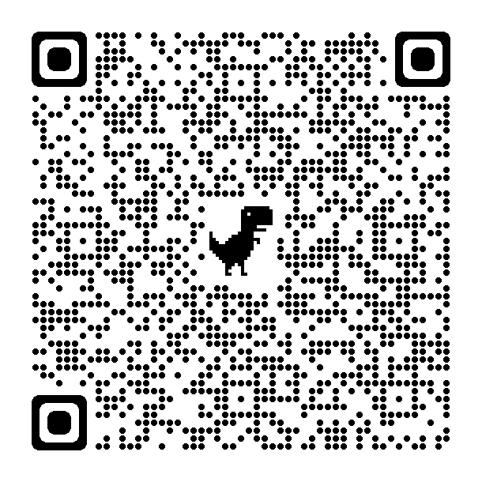
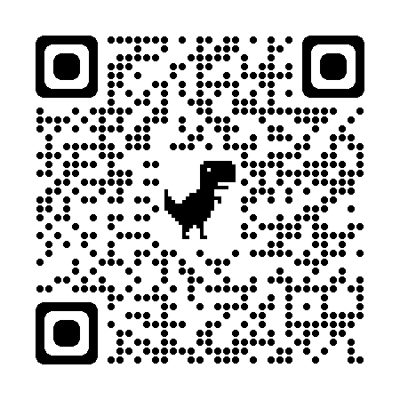
Q/A
Slides by Raghav Bali (raghavbali.github.io)
Book Link
For more such interesting and usable generative models, refer to “Generative AI with python and TensorFlow 2”
Connect with me
On LinkedIn
Notes:
Slides by Raghav Bali (raghavbali.github.io)

